Slide 1

The Door Switch
Patent Approved 7466237
Life More Secure.
Why is the Door Switch Patent Important?

Slide 2
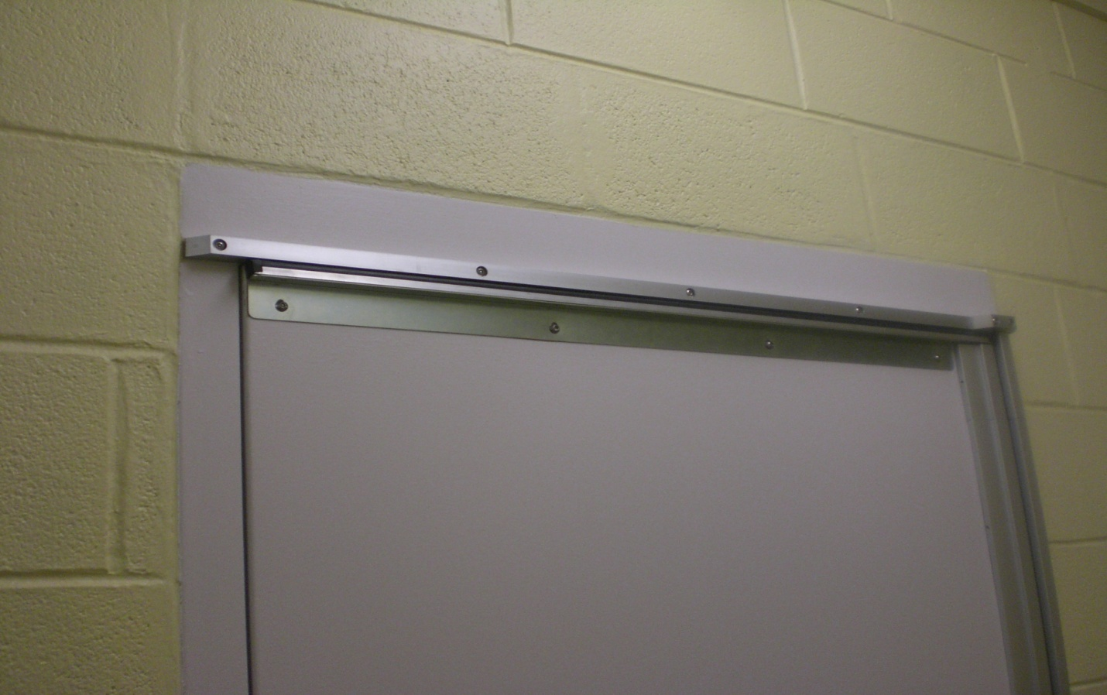
Pressure is the Key
As Recommended in The Design Guide of Behavioral Health
“The top of all tight-fitting doors provides a pinch point that allows a patient to tie a knot (in a sheet, the leg of a pair of jeans or other object), place it over the top of the door, and close the door. This provides a hanging device. One way to reduce this risk is with a pressure-sensitive device placed on the top of the door that sounds an alarm.”

Slide 3
Evidence Based Design
According to Jim Hunt:
“… the more residential and less institutional the look of the place the better.”
“The units need to be relatively subdued and calming….”
Five Important Issues to Consider
Patient safety
Staff safety
Therapeutic environment
Infection control
Building and fire codes

Slide 4
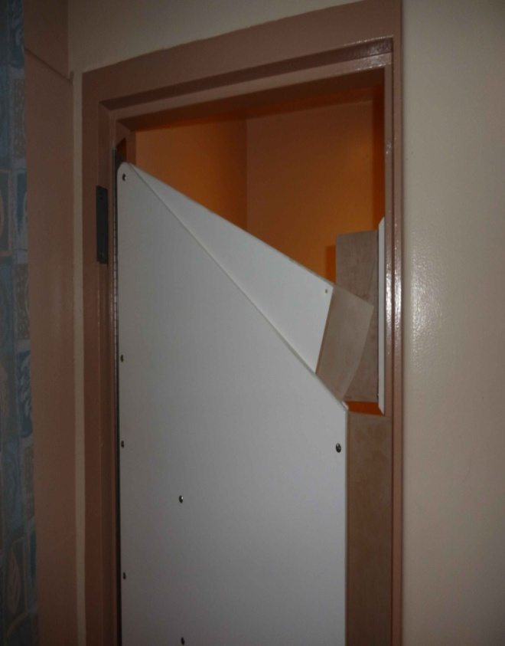
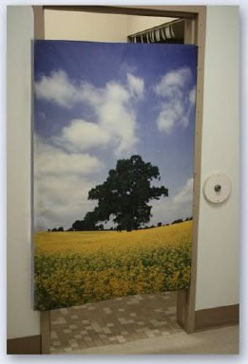
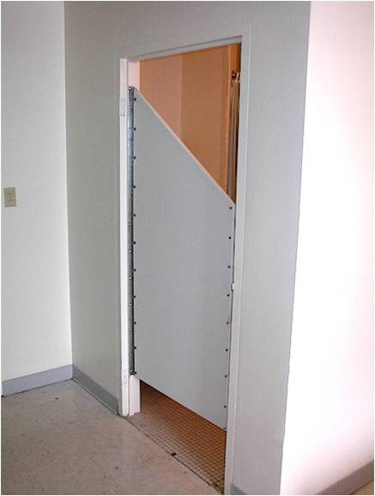
Their Solution
Total Door Replacement
Norva Plastic Doors
Soft Material Suicide Proofing Door

Slide 5
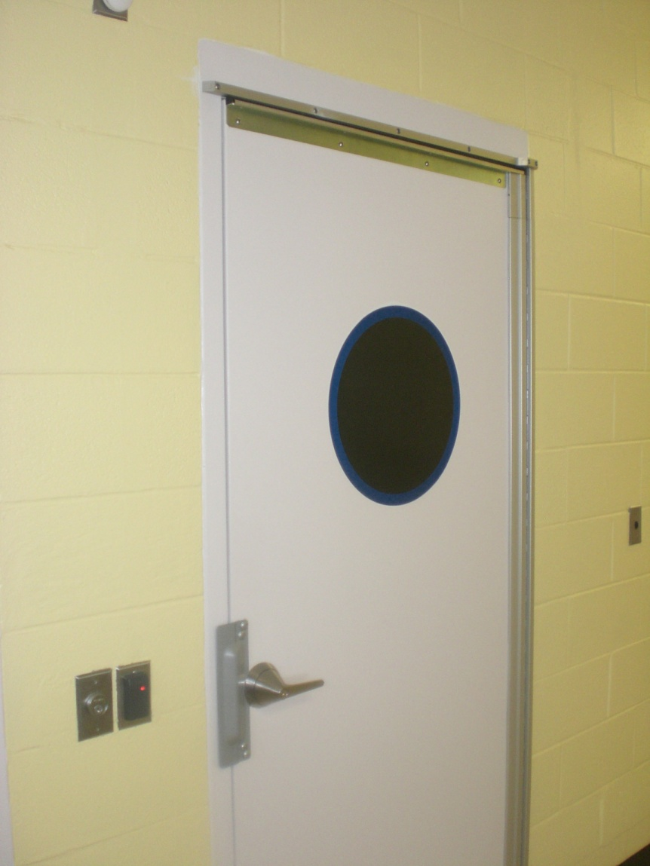
Our Solution
A Retrofit Design
Header Device Frame
Strobe Light
Rubber Encased Alarm
Key switch
Monitored Panel
Continuous Hinge

Slide 6

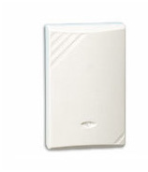
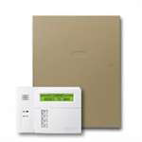
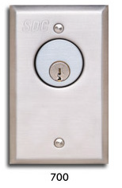
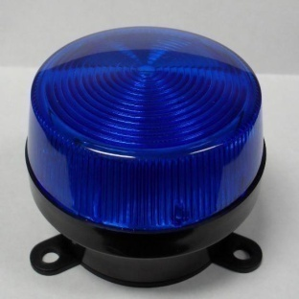
The Door Switch System

Slide 7
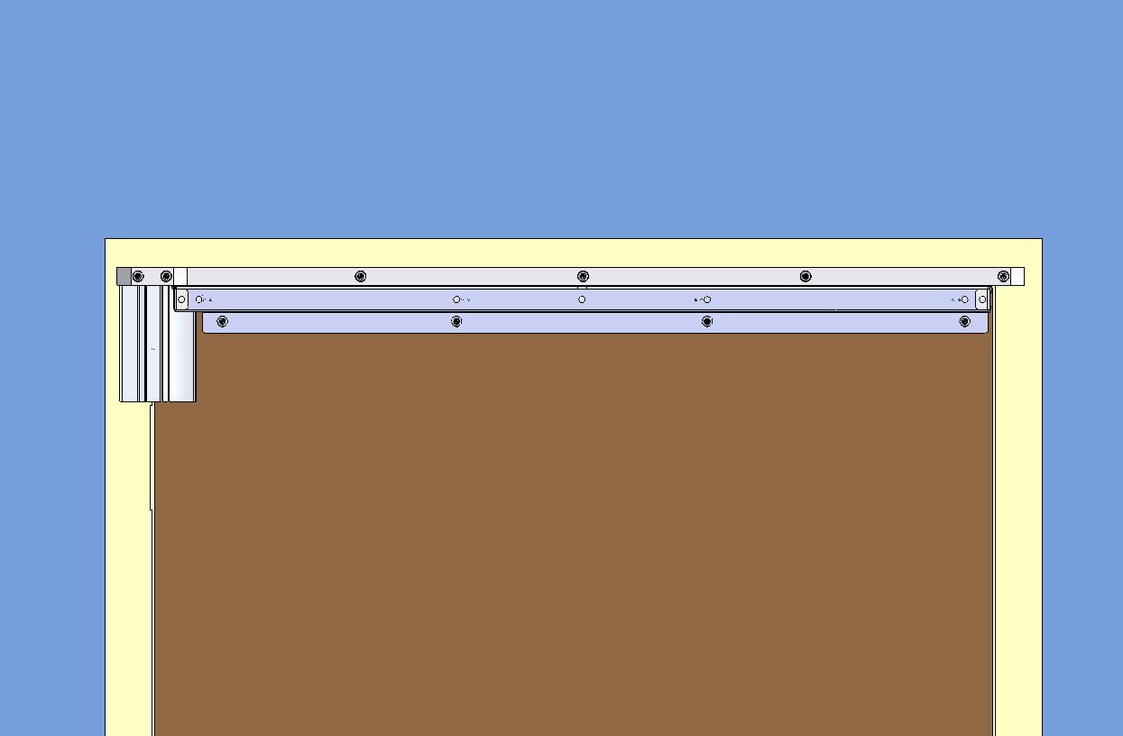
The Door Switch
New Micro Switch Technology
Low Profile Design
Increased Pressure Sensitivity
Maintained Low False Alarms Activity
Smarter design includes use of resistors without compromising switch sensitivity on ends

Slide 8
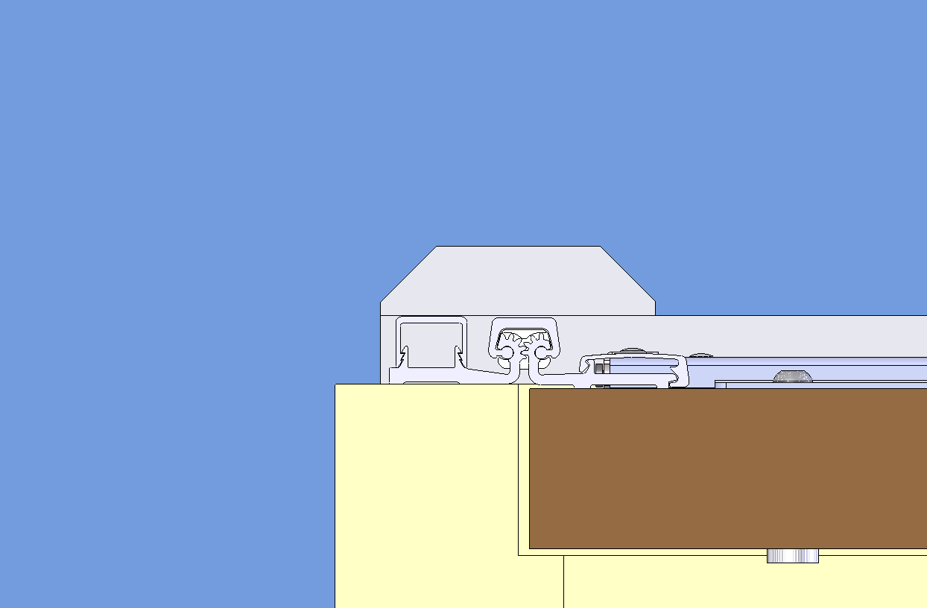
The New Door Switch Provides the Most Coverage

Slide 9

The Door Switch Retrofits
on Double Acting Doors

Slide 10

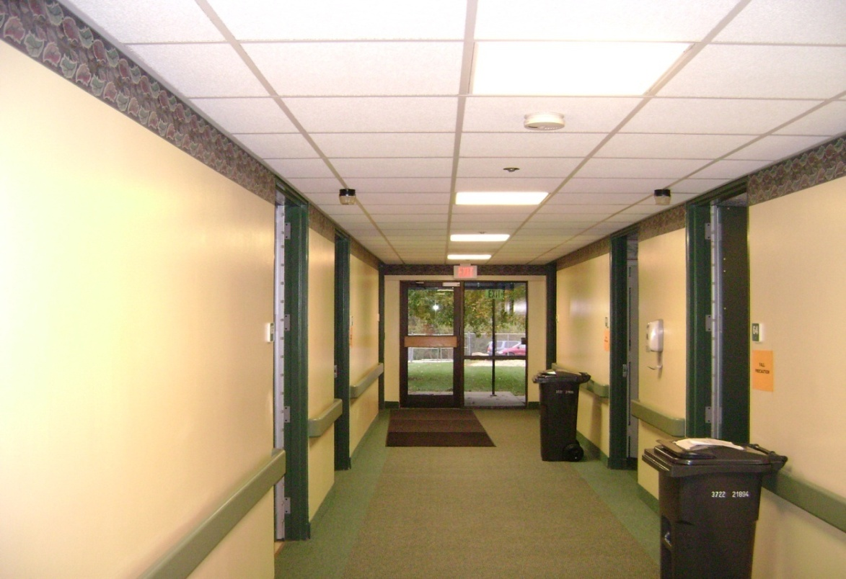
The Door Switch Performs
The Challenge
    Patients privacy
    Minimal distraction to patient program
    No “Cry Wolf” Alarms
    Preventative solution
    Maintains therapeutic environment
    Does not intrude in patient program
    Tested in field
    Effective nursing tool
The Door Switch Meets These Needs
“ I have engrained in me a strong value for life. That is my driving force. I want to help people.” - Frank Cook

Slide 11
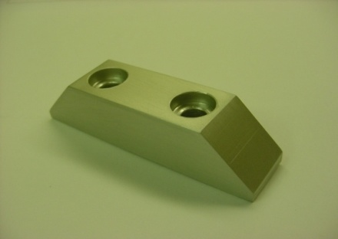
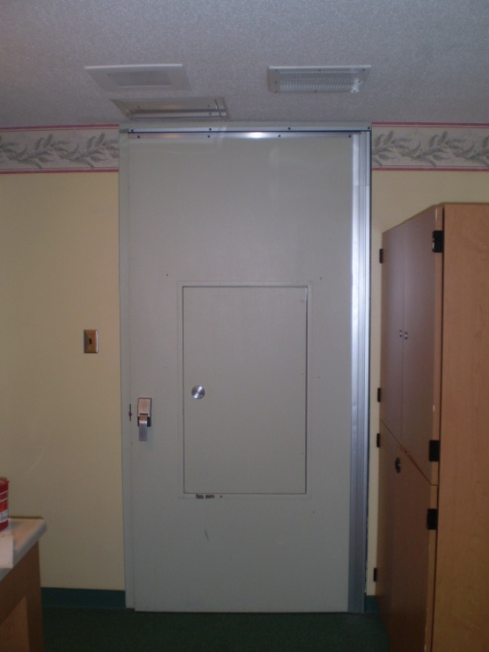
The Door Switch Provides…
The Fastest, Most Reliable Response Time
It is the only over the door pressure device on the market.
It’s patented design provides coverage that is raised above the door.

Slide 12
Recommended by Experts
Trusted by Nursing Staff
The Door Switch is recommended by behavioral health consultants and architects.
It is seen in the 2011 updated Design Guide.
The Door Switch Recent Praise
“It’s wonderful. It’s working really well. We are very pleased.”
Joanne Robinson
nurse manager
Calvert Memorial Hospital
(410) 535-8137

